Slide 1


Slide 2
What is CloudHour?
Objective of CloudHour
Round-table discussion
Focus on a few key topics
Why It's Important
Rapid changes in cloud security and tech
Stay updated and connected for growth as community
How it will benefit the community
Real-time engagement with hosts and community members
Ask open questions and speak your opinion
Opportunity to affect the next agenda
Notes:
Objective of CloudHour
The objective of CloudHour is to create a collaborative space where professionals can come together to discuss, learn, and share insights on the most pressing topics in cloud security and modern workplace technology.
Why its important
CloudHour is important because, in the rapidly evolving landscape of cloud security and workplace technologies, staying updated and connected is crucial for career growth and organizational resilience
How it will benefit the community
By attending CloudHour, community members will have the unique opportunity to engage with industry experts in real-time, ask questions, network with like-minded professionals, and even have the chance to contribute their own expertise by becoming guest speakers in future episodes.

Slide 3

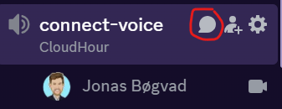
If you prefer to not talk or be asked questions press mute
press mute just mute the mic
If you preferer to chat press

Slide 4
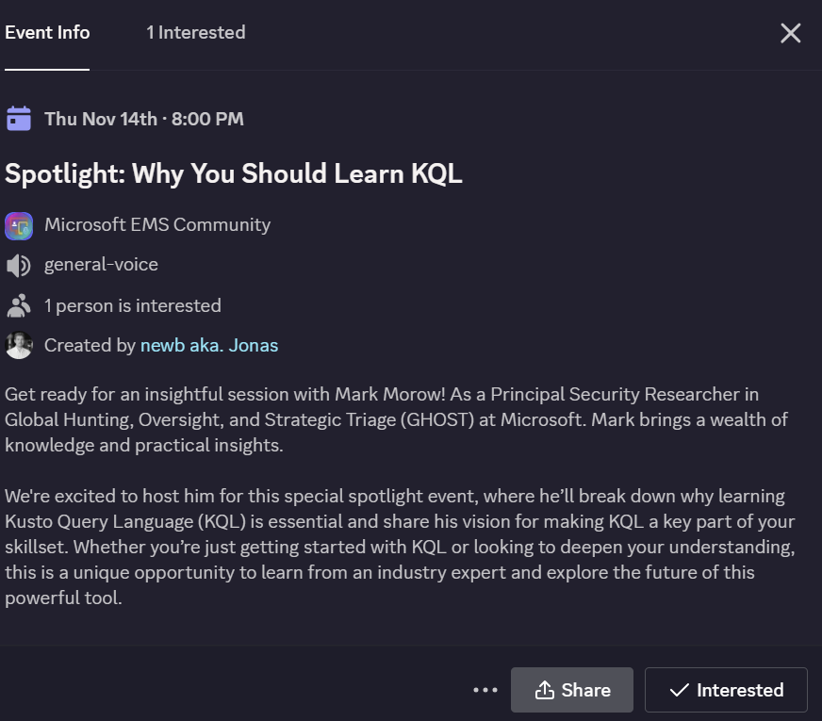
Events in the making
Mark Morow from Microsoft to come and talk about KQL (confirmed 👍)
Merill from Microsoft and core team to come and talk about Measter in december (almost confirmed 💪)
Podcast release with Rudy Ooms

Slide 5
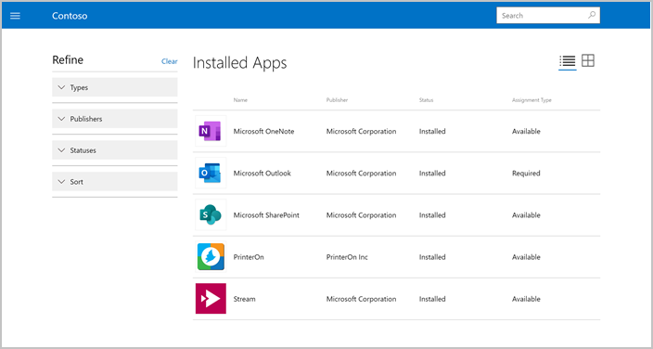
Maybe for you (feel free to add)
Windows 10 October 14, 2025 end of life
New UI for the Intune Company Portal App
Windows Server 2025 Security Book
Microsoft Secure Future Initiative
Microsoft Ignite reminder to make your sch
Updates to Security Defaults
QR code phishing
Notes:
https://techcommunity.microsoft.com/blog/microsoftsecurityandcompliance/windows-server-2025-security-book/4283981
https://ignite.microsoft.com/en-US/sessions
https://techcommunity.microsoft.com/blog/identity/update-to-security-defaults/4044868

Slide 6
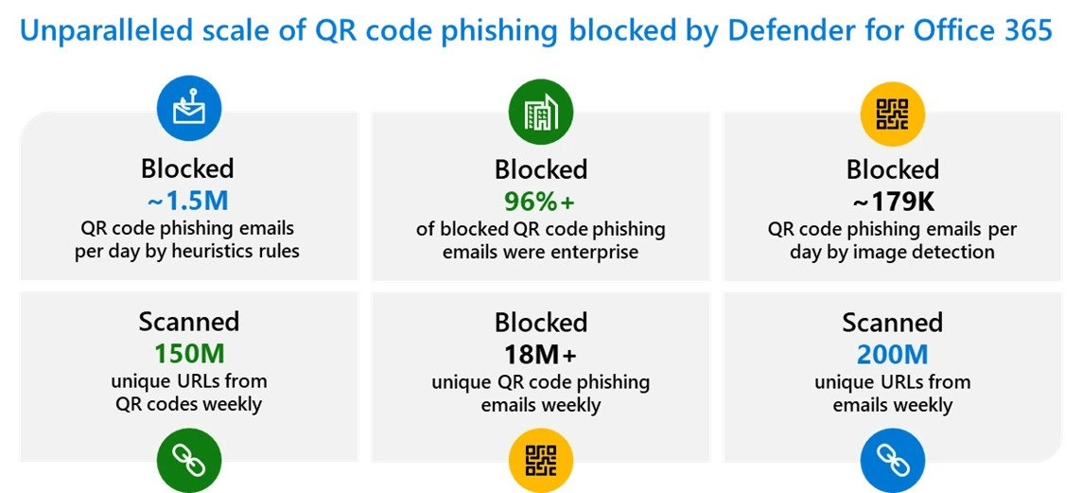
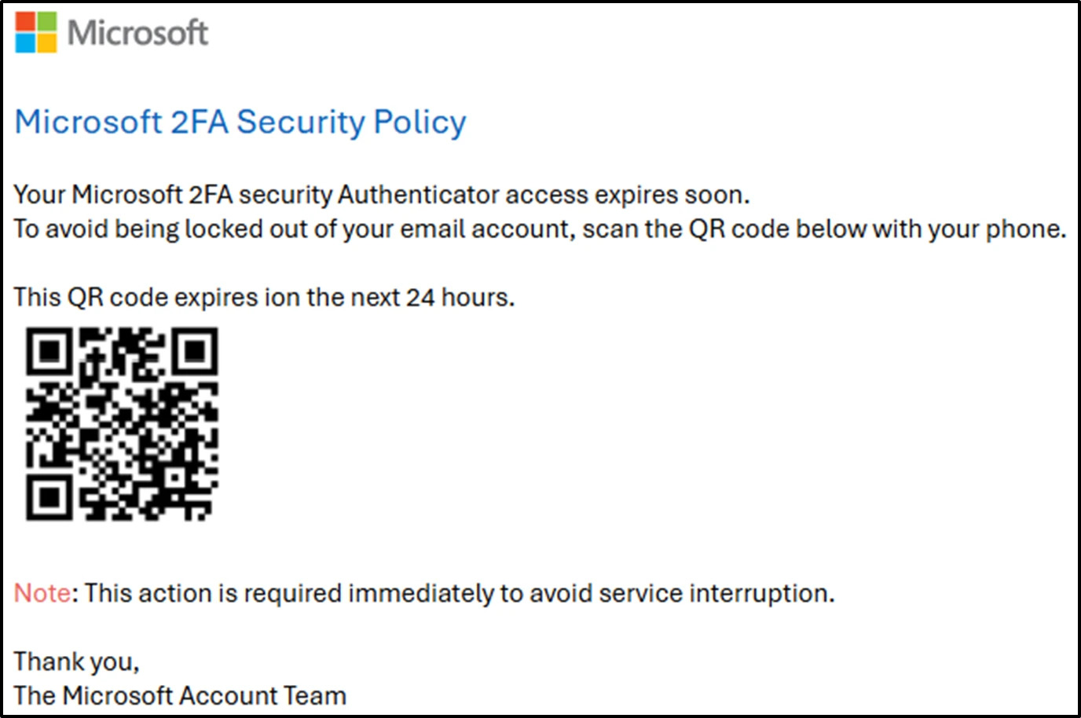
QR code phishing
Notes:
https://www.microsoft.com/en-us/security/blog/2024/11/04/how-microsoft-defender-for-office-365-innovated-to-address-qr-code-phishing-attacks/

Slide 7
Welcome & Agenda
24H2 Windows 11 (What is your experience)
Hybrid environments
Purview insights experiences
Token theft

Slide 8
24H2 Windows 11 (What is your experience)
No update from Windows Autopatch
Admin Protection (preview)
OCT CU 24H2, wierd UAC Prompts
Reboot takes a long time
Power saving features.
Lock Screen featuers (cant spell)
Lenovo feature conflict.
Personal Data Encryption

Slide 9
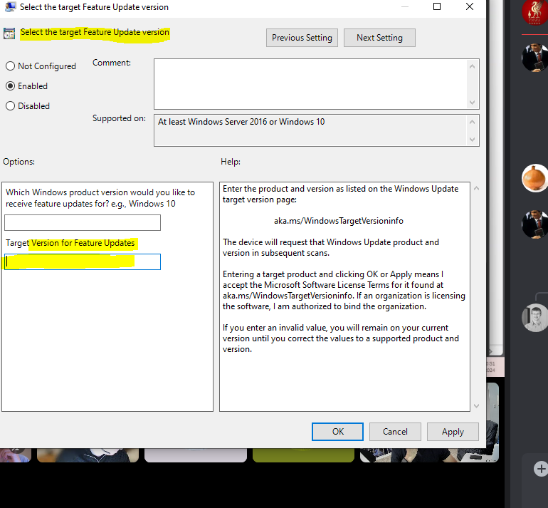
KB5044284 (Windows Server Upgrade)
Ping from today
Automaticlly upgrade to 2025
Third party update RMM specific issue
Registry key to prevent an upgrade (future releases)
Computer\HKEY_LOCAL_MACHINE\SOFTWARE\Policies\Microsoft\Windows\WindowsUpdate
½

Slide 10
Hybrid Environments (share your thoughts)
Footprint from old env
From GPO to Intune Management
Remove Enrollment Key in Registry
Maybe some management URLS are blocked, https inspection.

Slide 11
Purview insights experiences
Battle!
Mapping out sensitive data, with regex (no standard, very limited)
Layered approach
UI Not making it easy, for insights.
Files does not show up, different files from Audit to Production
Copilot AI Hub, seems like a good experience
First approach, work with compliance team, data governance team. Written policies in the details.
Play book for purview (https://microsoft.github.io/ComplianceCxE/playbooks/)
Microsoft tells us to go to the old portal.
Grey area of who support which feature (in the wild when asking for help feeling)

Slide 12
Token theft
https://learn.microsoft.com/en-us/security/operations/token-theft-playbook
https://techcommunity.microsoft.com/blog/identity/how-to-break-the-token-theft-cyber-attack-chain/4062700
Intune Management
Credential Guard (LSA)
Require device compliance
Token Theft playbook to get an overview
Entra ID
Passkeys (Thief)
https://github.com/jkerai1/So-You-ve-Got-MFA-Defending-and-Responding-Against-MFA-Bypass-Techniques-in-Entra
Notes:
https://learn.microsoft.com/en-us/security/operations/token-theft-playbook
https://techcommunity.microsoft.com/blog/identity/how-to-break-the-token-theft-cyber-attack-chain/4062700

